Slide 1
Anatomy of the Temporal Region
BY
DR. A.O OJEWALE

Slide 2
Outline
Intro (Temporal region)
Temporal Fossa
Boundaries
Contents
Infratemporal Fossa
Intro
Communications
Boundaries
Contents
Applied Anatomy

Slide 3
Intro’
Structures located in the temporal region are two fossae (temporal and infratemporal fossae) separated by the zygomatic arch.
Temporal fossa
It is the fan shaped space located on the lateral side of the skull above the zygomatic arch.
It contains temporalis muscle, its fascia, and neurovascular structures.
It communicates with the infratemporal fossa deep to the zygomatic arch. The infratemporal crest of the sphenoid separates the two fossae.

Slide 4
Boundaries
It is bounded: Anteriorly by the posterior surface of the frontal process of the zygomatic bone and the posterior surface of the zygomatic process of the frontal bone.
Posteriorly and superiorly by the temporal lines.
Inferiorly by the infratemporal crest of the greater wing of sphenoid bone
Laterally by the temporal fascia, which is overlying the temporalis muscle
Medially (the floor) by four adjoining bones: frontal, temporal (squamous), parietal, and (greater wing of) sphenoid bones.

Slide 5
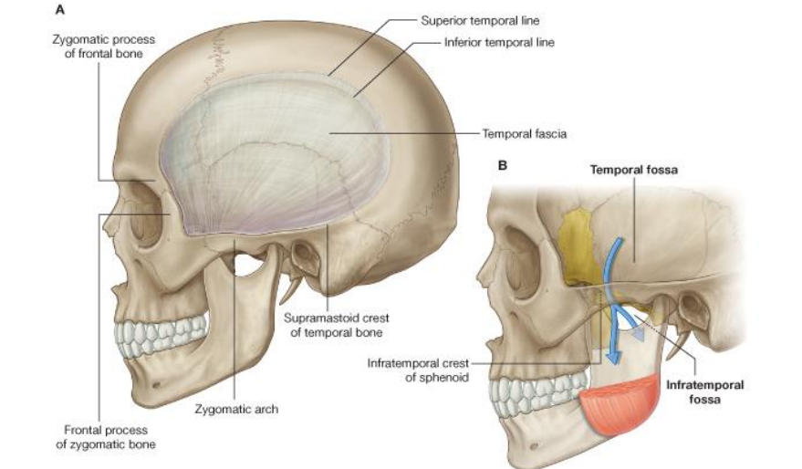
Temporal and infratemporal boundaries

Slide 6
Pterion
It is a small circular area in the floor of the temporal fossa where the [parietal, frontal, greater wing of sphenoid, temporal, (squamous)] bones of this floor meet to form an H-shaped suture.
It is located (its centre) about 3.5 cm behind the frontozygomatic suture and about 4.0 cm above the zygomatic arch.
It is an important surgical and anatomical landmark
It overlies the anterior branch of middle meningeal artery; this may rupture in fracture of this region

Slide 7
Contents of temporal fossa
Temporalis muscle
Zygomaticotemporal nerve
Deep temporal nerve
Deep temporal artery

Slide 8
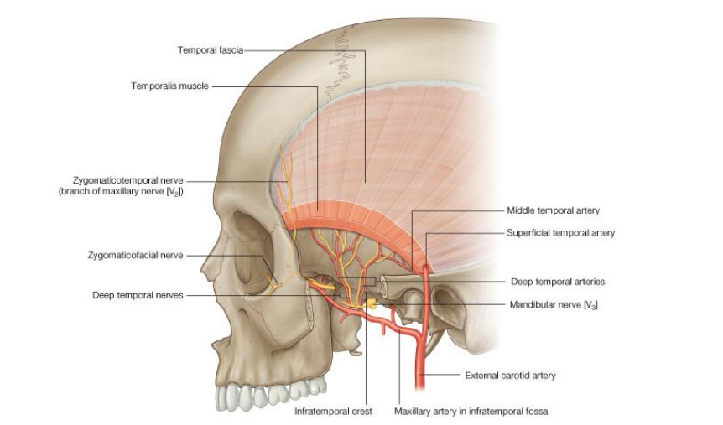
Contents of temporal fossa

Slide 9
The temporal fascia
It is a strong fibrous sheet that covers temporalis and forms the roof of the temporal fossa.
It is attached above to the superior temporal line and below to the zygomatic arch.
Proximal attachment
Floor of the temporalis fossa
Deep surface of temporal fascia

Slide 10
Cont’d
Distal attachment
Apex and medial aspect of the coronoid process of the mandible
Anterior border of mandibular ramus
Innervation
Deep temporal nerves (from the anterior division of mandibular nerve)
Actions
It elevates the mandible (and thus closes the mouth) - a function of its anterior fibres
It retracts the mandible (from a protruded position) -a function of its posterior fibres

Slide 11
The temporalis muscle
It is a large fan-shaped muscle that fills much of the temporal fossa.
Proximal attachment
The bony surfaces of the fossa and the temporal fascia
Distal attachment: Coronoid process of the mandible
The more anterior fibers are oriented vertically while the more posterior fibers are oriented horizontally.
Blood supply: Deep temporal arteries
Nerve supply: Deep temporal branches of the mandibular nerve .

Slide 12
Infratemporal fossa
It is an irregular space located behind the maxilla.
It contains several structures, which include muscles, vessels, and nerves (in close interrelationship with each other)
It communicates with the temporal fossa through the interval between the zygomatic arch and the lower part of the temple.
It also communicates with the middle cranial fossa through the foramina ovale and spinosum (located in its roof).

Slide 13
Boundaries of the Infratemporal fossa
With the mandible in place, the infratemporal fossa is bounded:
Anteriorly by the posterior surface of the maxilla
Superiorly (the roof) by the greater wing of sphenoid bone, and adjacent part of the squamous part of temporal bone.
Inferiorly by no anatomical structure
Medially by the lateral pterygoid plate
Laterally by the mandibular ramus

Slide 14
Cont’d
Posteriorly by the mastoid and styloid processes (of the temporal bone) and the tympanic plate.

Slide 15
Contents of the Infratemporal fossa
Numerous structures are crammed in the infratemporal fossa; these include:
Muscles - medial and lateral pterygoid, and lower part of temporalis
Arteries - maxillary artery and its numerous branches.
Veins - pterygoid plexus of veins
Nerves - mandibular nerve and its branches, and the chorda tympani.
Ganglion - otic ganglion.

Slide 16
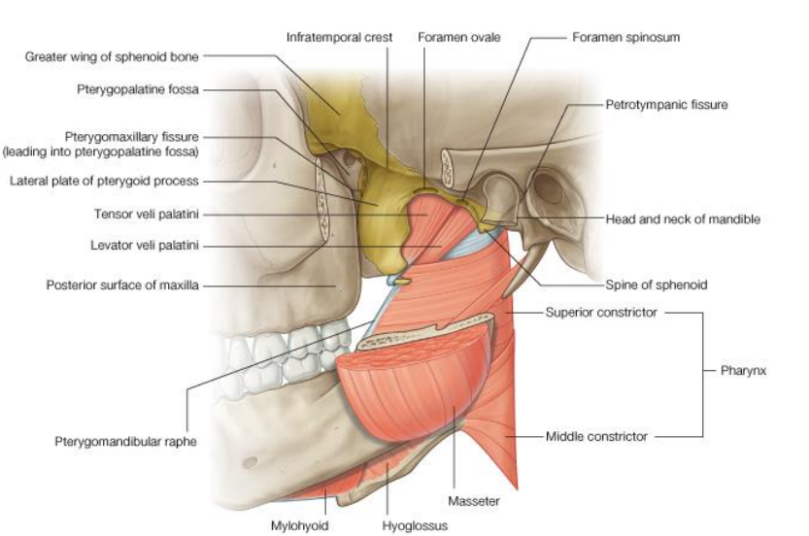
Boundaries and contents of the Infratemporal fossa

Slide 17
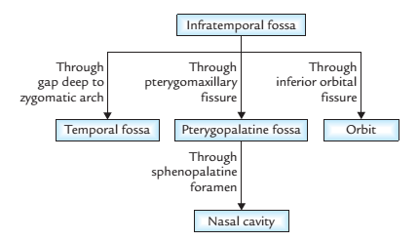
Communications of the infratemporal fossa

Slide 18
Muscles of Infratemporal fossa
Lower part of temporalis
Lateral pterygoid
Medial pterygoid

Slide 19
The lateral pterygoid
It has two heads of origin: upper and lower heads.
It converges posterolaterally from its sphenoidal origin to its mandibular insertion.
It is regarded as the key muscle of the infratemporal region because its relations provide a fair idea about the layout of structures in this region.
It is traversed (between its two heads) by the buccal nerve, as this descends towards through the infratemporal fossa.

Slide 20
Cont’d
It is related laterally to the mandibular ramus, masseter, and temporalis, medially to (the upper part of) medial pterygoid, sphenomandibular ligament, mandibular nerve, and middle meningeal artery.
The maxillary artery traverses the infratemporal fossa either deep or superficial to the lateral pterygoid.
The lingual and inferior alveolar nerves descend through the infratemporal fossa close to the lower border of lateral pterygoid.
The nerves to masseter and temporalis ascend in the infratemporal fossa close to the upper border of lateral pterygoid.

Slide 21
Cont’d
Proximal attachment
Upper head: Infratemporal surface and crest of the greater wing of sphenoid.
Lower head: lateral surface of the lateral pterygoid plate.
Distal attachment
Fibrous capsule and disc of the temporomandibular joint (TMJ).
Neck of the mandible

Slide 22
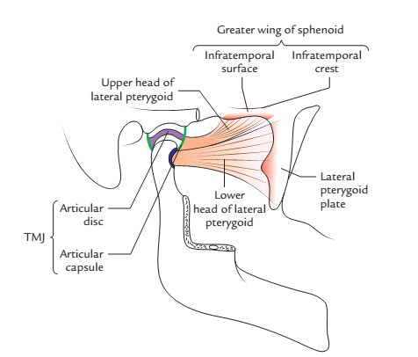
Cont’d
Origin and insertion of the lateral pterygoid muscle

Slide 23
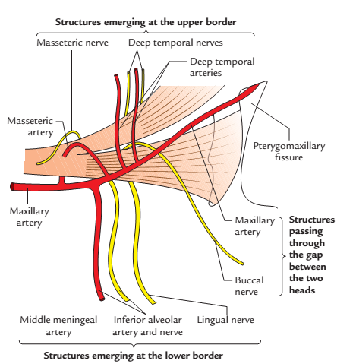
Relation of the lateral pterygoid muscle

Slide 24
Cont’d
Innervation:
Deep temporal nerve (from the anterior division of the mandibular nerve).
Actions:
Protrudes the mandible, thereby opening the mouth (when acting simultaneously with the opposite muscle).
Produces side to side movements of the mandible (when acting alternately with the opposite muscle).

Slide 25
The medial pterygoid
It is a thick quadrilateral muscle located in the infratemporal fossa.
It arises by two heads-superficial and deep heads. These embrace the (lower part of lateral pterygoid).
It descends posterolaterally from its pterygoid (and maxillary) origin to its mandibular insertion.
It is related laterally to the mandibular ramus, lateral pterygoid, and sphenomandibular ligament.
It is related medially to tensor veli palatini.

Slide 26
Cont’d
Proximal attachment
Deep head: medial surface of the lateral pterygoid plate and the pyramidal process of palatine bone.
Superficial head: tuberosity and pyramidal process of the maxilla.
Distal attachment
Medial aspects of mandibular ramus and angle (behind and below the mylohyoid groove and mandibular foramen).
Innervations
A branch from the trunk of the mandibular nerve

Slide 27
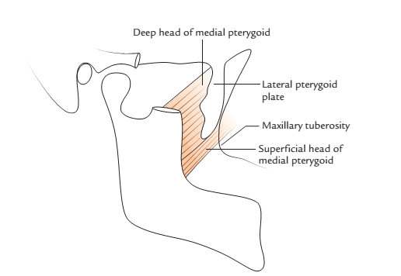
Cont’d
Origin and insertion of the medial pterygoid
muscle

Slide 28
Cont’d
Actions:
Elevates the mandible and thus closes the mouth (when acting simultaneously with the opposite muscle).
Produces grinding movements, i.e., chewing (when acting alternately with opposite the medial pterygoid).
Protrudes the mandible (together with the lateral pterygoids).

Slide 29
Arteries of the Infratemporal Fossa
These include:
Maxillary artery and its branches.
It is the largest branch of the external carotid artery in the neck and is a major source of blood supply for the nasal cavity, the lateral wall and roof of the oral cavity, all teeth, and the dura mater in the cranial cavity. It passes through the infratemporal fossa and supplies it. It then enters the pterygopalatine fossa, where it gives origin to terminal branches.

Slide 30
Cont’d
It originates within the substance of the parotid gland and then passes forward, between the neck of mandible and sphenomandibular ligament, into the infratemporal fossa. It ascends obliquely through the infratemporal fossa to enter the pterygopalatine fossa by passing through the pterygomaxillary fissure. This part of the vessel may pass either lateral or medial to the lower head of lateral pterygoid. If it passes medial to the lower head, the maxillary artery then loops laterally between the upper and lower heads of lateral pterygoid to access the pterygomaxillary fissure.

Slide 31
Branches of the maxillary artery
Branches of the 1st part of the maxillary artery are five (5). These include:
Deep auricular artery
Anterior tympanic artery
Middle meningeal artery
Accessory meningeal artery
Inferior alveolar artery

Slide 32
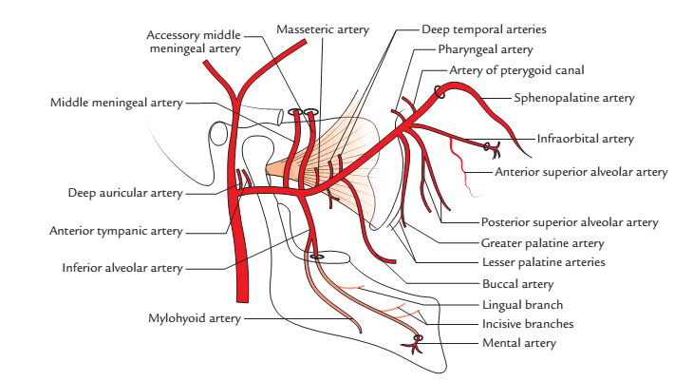
Branches of the maxillary artery

Slide 33
Cont’d
Branches of the 2nd part of the maxillary artery supply muscles of mastication; These include:
Anterior and posterior deep temporal arteries; these ascend deep to the temporalis, which they supply.
Pterygoid branches, to medial and lateral pterygoid muscles.
Masseteric branch, which traverses the mandibular notch (behind temporalis) to reach the deep aspect of the masseter, which it supplies
Buccal branch, which accompanies the buccal nerve to supply buccinator and the mucosa of the cheek.

Slide 34
Cont’d
Branches of the 3rd part of the maxillary artery include
Posterior superior alveolar artery
Infraorbital artery
Descending palatine artery
Artery of the pterygoid canal
Pharyngeal artery
Sphenopalatine artery.

Slide 35
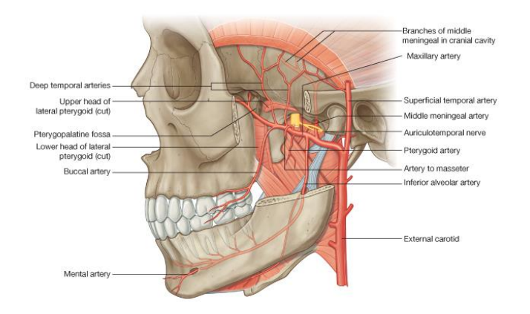
Blood supply of temporal and infratemporal region

Slide 36
Veins of the Infratemporal fossa
Maxillary vein
It drains the pterygoid plexus of veins
It is accompanied by the 1st part of the maxillary artery as it passes backwards from its origin (between the mandibular neck laterally, and the sphenomandibular ligament medially)
It unites with the superficial temporal vein (behind the neck of mandible) to form the retromandibular vein.

Slide 37
Cont’d
Pterygoid plexus of veins
It is located in the infratemporal fossa between the medial and lateral pterygoid muscles, and also between the lateral pterygoid and temporalis.
It receives tributaries that drain, to a larger extent, the territories of branches of the maxillary artery.
It communicates with the facial vein (through the deep facial vein).
It is also communicates with the cavernous sinus (through emissary veins that traverse foramina ovale and lacerum, and the sphenoidal emissary foramen.

Slide 38
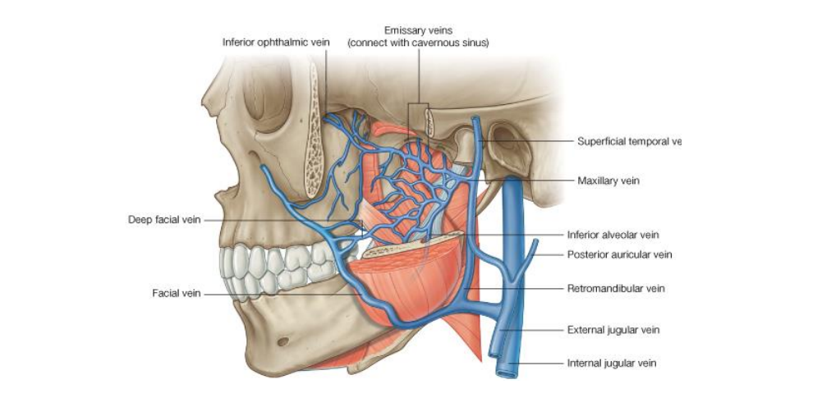
Cont’d
It is drained by the maxillary vein.
Venous drainage of temporal and infratemporal fossa

Slide 39
Nerves of the Infratemporal fossa
These include:
The mandibular nerve and its numerous branches, and
The chorda tympani branch of facial nerve.

Slide 40
Mandibular nerve
It is the largest of the three divisions of the trigeminal nerve.
It has a large sensory root and a small motor root ; the latter lies beneath the trigeminal ganglion as it passes towards the foramen ovale.
It traverses the foramen ovale as two separate roots (sensory and motor), which unite just beyond the foramen to form the trunk of the mandibular nerve.
It divides in the infratemporal fossa, into a larger posterior and a smaller anterior division

Slide 41
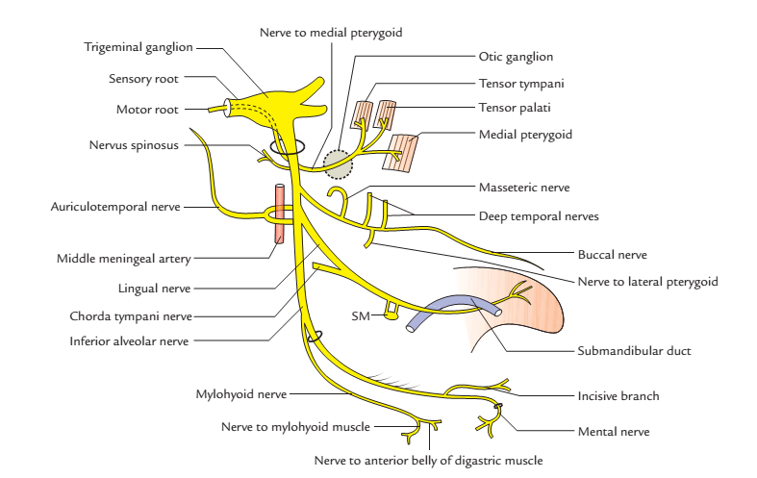

Slide 42
Branches of the mandibular nerve
They arise from
The trunk of the mandibular nerve
Its anterior division, and the posterior division.
Nerves that arise from the main trunk of the mandibular nerve include:
Meningeal branch (nervus spinosus), and
Nerve to medial pterygoid

Slide 43
The meningeal branch of the mandibular nerve
It arises from the medial aspect of the mandibular nerve in the infratemporal fossa.
It ascends (with the middle meningeal artery) through the foramen spinosum (to the middle cranial fossa).
It gives sensory branches to the dura of the middle and anterior cranial fossae and that of the calvaria, as well as the mucosa of the mastoid air cells.

Slide 44
The nerve to medial pterygoid
It is also arises from the medial aspect of the trunk of the mandibular nerve, in the infratemporal fossa.
It innervates the medial pterygoid muscle.
It also sends branches to the tensor tympani and tensor veli palatini; these branches pass through the otic ganglion.

Slide 45
Cont’d
Branches of the anterior division of mandibular nerve are largely motor. They include:
Masseteric nerve
Deep temporal nerves
Nerve to lateral pterygoid, and
Buccal nerve

Slide 46
Masseteric nerve
It passes laterally through the infratemporal fossa, above the lateral pterygoid (and just anterior to the capsule of TMJ).
It continues laterally through the mandibular notch (behind temporalis tendon)
It innervates masseter (through the deep surface of the masseter) and the TMJ.
It is accompanied by the masseteric artery

Slide 47
Deep temporal nerves
They usually occur as anterior and posterior deep temporal nerves; an intermediate one may be present.
They pass laterally through the infratemporal fossa, above the lateral pterygoid. Then
They turn upwards to enter the temporal fossa where they innervate temporalis (via the deep surface of the temporalis.

Slide 48
Nerve to lateral pterygoid
It supplies the lateral pterygoid through its deep surface.
May share a common stem with the buccal nerve.

Slide 49
The buccal nerve
It is the sensory branch of the anterior division of the mandibular nerve.
It lies first between the two heads of lateral pterygoid, it then
It descends to the cheek deep to (or through) the lower part of temporalis, masseter, and mandibular ramus.
It innervates the skin and mucosa over the anterior part of buccinator.
It also innervates the gums
It may give rise to the anterior deep temporal nerve
It is joined by the buccal branch of facial nerve (a motor ramus).

Slide 50
Cont’d
Branches of the posterior division of mandibular nerve are mainly sensory; these include:
Auriculotemporal nerve
Lingual nerve
Inferior lingual nerve:
Lingual nerve
It arises from the posterior division of the mandibular nerve, in the infratemporal fossa.

Slide 51
Cont’d
The lingual nerve descends first between tensor veli palatini medially, and lateral pterygoid laterally.
It continues downwards and forwards between the medial pterygoid medially and mandibular ramus laterally (anterior to the inferior alveolar nerve).
It lies on the mandible near the 3rd molar tooth (below the inferior margin of the superior pharyngeal constrictor); here, it is covered by the buccal mucosa and can be felt by a finger in the mouth.

Slide 52
Cont’d
It continues forwards on the stylohyoid and the lateral aspects of hyoglossus and genioglossus (deep to mylohyoid, and above the deep part of submandibular gland).
It crosses the submandibular gland first laterally, inferiorly and then medially, before ascending on the lateral aspect of genioglossus.
It innervates the mucosa of the anterior 2/3rd of the tongue.

Slide 53
Cont’d
It is joined by the chorda tympani (in the infratemporal fossa) ; this branch of facial nerve conveys presynaptic parasympathetic fibres to the submandibular ganglion.
It is also joined by fibres which arise from the submandibular ganglion, these contain secretomotor (postganglionic parasympathetic) fibres to the sublingual and anterior lingual glands.

Slide 54
Branches of the lingual nerve
The lingual nerve gives:
Sensory fibres to the mucosa of the floor of the mouth.
Sensory branches to the lingual aspects of the lower gingivae (gums)
Sensory rami to the lower premolar and 1st molar teeth
Branches to the mucosa of the oral part (anterior 2/3rd or presulcus part) of the tongue.

Slide 55
Cont’d
Secretomotor fibres to the sublingual and anterior lingual glands. These fibres arise from the submandibular ganglion.
Communicating rami to branches of the hypoglossal nerve (at the apex of the tongue) via these rami, sensory fibres may be distributed to the tongue.

Slide 56
The inferior alveolar nerve
It arises from the posterior division of the mandibular nerve, in the infratemporal fossa.
It descends deep to the lateral pterygoid (behind the lingual nerve).
It lies between the sphenomandibular ligament medially and the mandibular ramus laterally as it enters the mandibular canal through the mandibular foramen.
It is accompanied by the inferior alveolar artery (from the 1st part of maxillary artery).

Slide 57
Cont’d
It gives rise to mylohyoid nerve just before it enters the mandibular foramen; this innervates mylohyoid muscle.
It forms an inferior dental plexus from the numerous branches (which arise in the mandibular canal); this plexus innervates the mandibular teeth, gums and alveolar processes.
It innervates the mandibular teeth, gums, and skin of the chin.

Slide 58
Branches of inferior alveolar nerve include
Mylohyoid nerve, which pierces the sphenomandibular ligament, and traverses the mylohyoid groove , to supply mylohyoid. It is accompanied by the mylohyoid artery.
Nerves to the lower molar and premolar teeth, these fibres also supply the gums and alveolar processes of the mandible.
Incisive nerve, which innervates the lower incisor and canine teeth.
Mental nerve, which emerges from the mental foramen to innervate the skin of the chin and that of the lower lip (and its mucosa).

Slide 59
Chorda tympani
It arises from the facial nerve about 6 mm above the stylomastoid foramen, it then passes forwards and upwards into the middle ear.
It crosses the tympanic membrane from behind forwards (between the fibrous layer and mucous lining of the tympanic membrane), in the lateral wall of the tympanic cavity.
It leaves the middle ear to enter the infratemporal fossa, where it joins the lingual nerve at an acute angle.

Slide 60
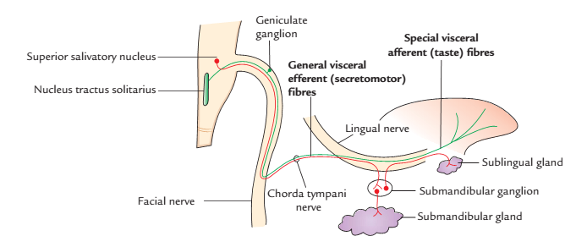
Cont’d
It conveys preganglionic parasympathetic fibres to the submandibular ganglion (via the lingual nerve); these fibres from the superior salivatory nucleus (in the lower pontine tegmentum).

Slide 61
Otic ganglion
It is a small reddish oval body located just below the foramen ovale (and medial to the mandibular nerve), in the infratemporal fossa.
It is one of the peripheral parasympathetic ganglia.
It receives preganglionic parasympathetic fibres from the glossopharyngeal nerve via the lesser petrosal nerve; these fibres arise from the inferior salivatory nucleus (located in the upper medullary tegmentum).
It is the source of postganglionic parasympathetic fibres to the parotid gland. These fibres are conveyed to the gland by the auriculotemporal nerve.

Slide 62
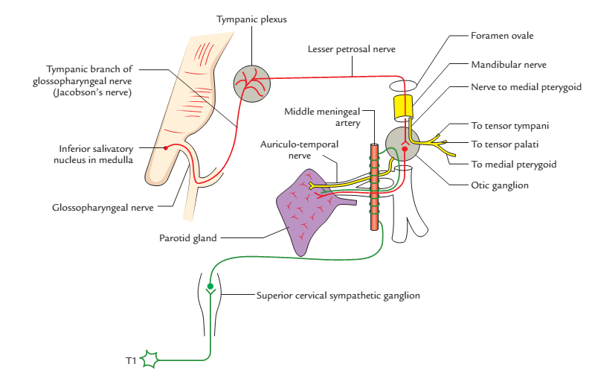
Cont’d
It is traversed by nerves to tensor tympani and tensor veli palatini (though these do not synapse in it).

Slide 63
Pterygopalatine Fossa
It is a narrow pyramidal space located below the apex of the orbit.
It is bounded by bones and it communicates with adjacent bony cavities via foramina.
It contains important nerves, blood vessels, and a ganglion (pterygopalatine ganglion).

Slide 64
Cont’d
It is bounded above by the greater wing of sphenoid bone.
It is bounded below (the floor) by the pyramidal process of palatine bone.
It is bounded anteriorly by the posterior surface of maxilla.
It is bounded posteriorly by the pterygoid process of sphenoid bone.
It is bounded medially by the perpendicular plate of palatine bone.

Slide 65
The Pterygopalatine Fossa communicates
Anterosuperiorly with the orbit through the inferior orbital fissure.
Posterosuperiorly with the middle cranial fossa through the foramen rotundum and the pterygoid canal.
Laterally with the infratemporal fossa through the pterygomaxillary fissure.
Medially with the nasal cavity through the sphenopalatine foramen.

Slide 66
The Pterygopalatine Fossa contains
Pterygopalatine ganglion (orbital branches, palatine (greater and lesser) nerves, nasal (lateral posterior superior nasal & medial posterior superior nasal including the nasopalatine foramen) nerves, and pharyngeal nerve.
Maxillary nerve and its branches (Paired ganglionic (pterygopalatine) branches, meningeal, zygomatic, posterior superior alveolar and infraorbital nerves.
(3rd) part of maxillary artery and its branches
Nerve of the pterygoid canal.

Slide 67
Applied Anatomy
Inferior alveolar nerve block is performed by injecting an anaesthetic agent around the mandibular foramen; this procedure largely abolishes sensations in the lower teeth. It is usually does not completely abolish sensations in the lower teeth; this is owing to the fact that nerve fibres also reach the mandibular teeth from nerves of the muscles attached to the mandible. It anesthetizes the mandibular nerve and its branches in the infratemporal fossa; the needle is passed into the infratemporal fossa through the mandibular notch.

Slide 68
Cont’d
The sphenomandibular ligament is an important landmark for administration of local anesthetic during inferior alveolar nerve block.
The temporal fascia is silvery-white thick fibrous sheet, which is more or less aponeurotic in character. It is the thickest fascia in the body. Structurally, it represents a shell of a bone. In some species (e.g., tortoise), it is replaced by bone to make the temporal fossa a bony tunnel.
The temporal fascia is as a graft used by ENT surgeons for tympanoplasty (repair of the tympanic membrane).

Slide 69
Cont’d
The lingual nerve is at great risk (10%) during surgical removal of the impacted third molar teeth. The nerve is also at risk during surgical removal of the submandibular salivary gland, during which the submandibular duct must be dissected out carefully from the nerve.
Therefore the patients suffering from tongue cancer, the pain radiates to the ear and to the temporal fossa in the area of distribution of auriculo-temporal nerve. The pain is relieved by dividing the lingual nerve below and behind the last molar tooth.

Slide 70
Cont’d
Referred Pain: It is the pain frequently referred from one branch of mandibular nerve to the other.

Slide 71


